Slide 1
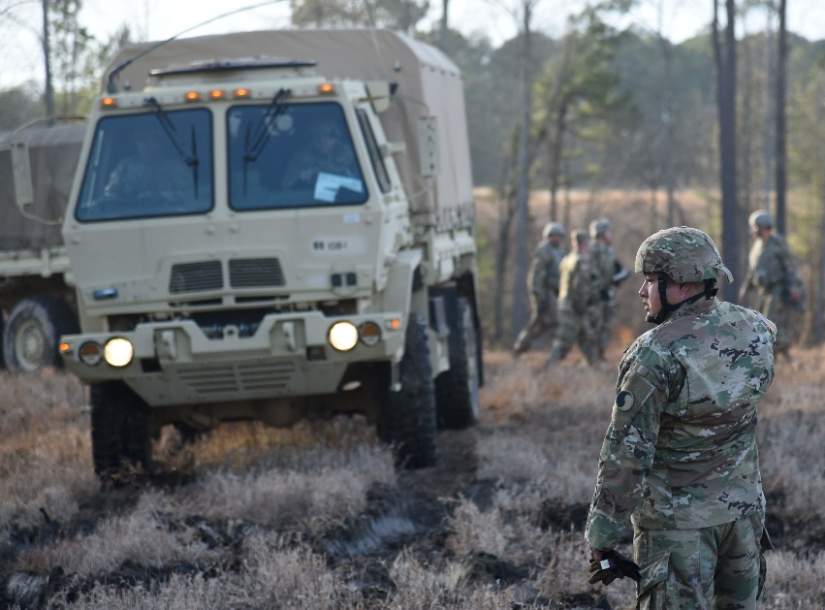
Reducing Vehicle
Registration Fees
VNGA
2021 Fact Sheet
The Issue
Virginia National Guard servicemembers continue to face challenges in reporting for individual and collective training given the geographic dispersion of units throughout Virginia. Vehicle registration fees should be reduced to support servicemembers travelling across Virginia to meet readiness and deployability requirements.
Virginia National Guard Soldiers assigned to the Danville-based 429th Brigade Support Battalion, 116th Infantry Combat Brigade Team occupy and set up a brigade support area during drill at Fort Pickett, Virginia.
Background
Recommendation
The Commonwealth of Virginia relies heavily on the “hometown Guard” to support local and regional emergencies. Having strategically placed Readiness Centers and facilities throughout Virginia allows emergency response capabilities to be readily accessible to emergency managers.
However, this also requires that servicemembers be assigned to these locations based off the capabilities requested at each of these locations. Additionally, as servicemembers gain proficiency and receive promotions, they may be required to report to duty stations well outside reasonable commuting distance.
The National Guard compensates servicemembers for travel only during periods of Annual Training and State Active Duty, but does not compensate them for travelling as part of routine Inactive Duty Training.
Amend § 46.2-744 of the Virginia Code to issue one set of special license plates at a discounted rate of 100 percent of the fees prescribed in § 46.2-694.
Currently, the Virginia Department of Motor Vehicles authorizes actively serving Virginia National Guard servicemembers reduced vehicle registration fees at a discounted rate of 50 percent for up to two vehicles.
This currently benefit fails to account for junior servicemembers with only one vehicle. Increasing the vehicle registration discount from 50 percent to 100 percent provides significant value to servicemembers required to travel longer distances to attend training events.
VNGA Contact K. Hoffman
Director of Advocacy
advocacy@vnga.us
Learn more at vnga.us

